Slide 1
Path to PED compliance of Cryo systems
04/09/2025

Slide 2
Intro project
PED compliance Cryo Module
PED compliance Cryo System

Slide 3

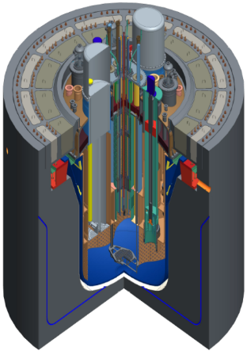
MYRRHA, project introduction
Purpose:
ADS technology demonstrator at pre-industrial scale
Flexible irradiation facility (Radio isotope production, reactor fuel research, …)
At SCK CEN – the Belgian nuclear research center
600 MeV Protons, 4mA - CW
MTBF > 250h for beam trips over 3s
3 types of SC-cavities
SUBCRITICAL REACTOR (~70MWth)

Slide 4
MYRRHA, a phased approach
Phase 2 - 600 MeV
Phase 1 - 100 MeV
Phase 1 – currently being Constructed
Linear Particle Accelerator
100 MeV Protons, 4mA
Phase 3 - Reactor

Slide 5
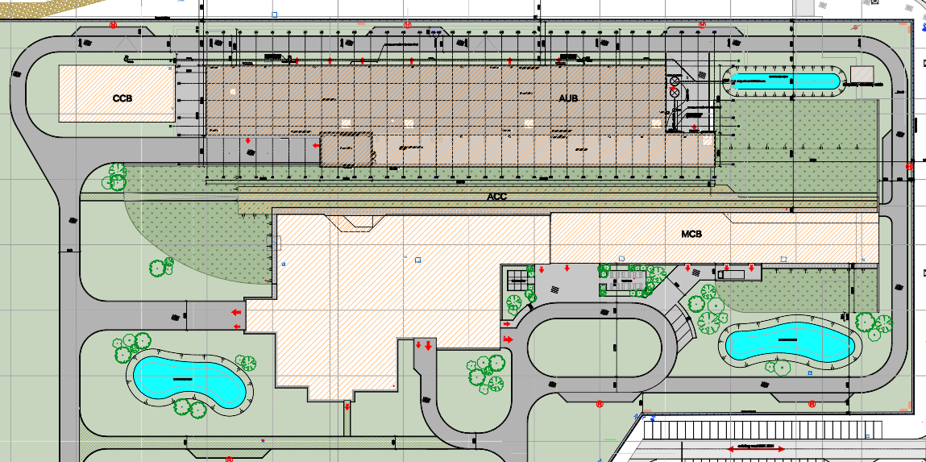
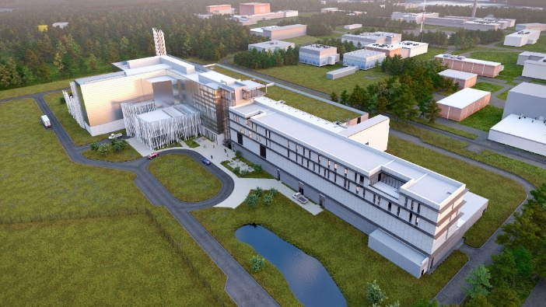
Building & infrastructure
CRYO
Accelerator utilities
RF GALLERY
stack
Central building
User building

Slide 6
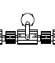
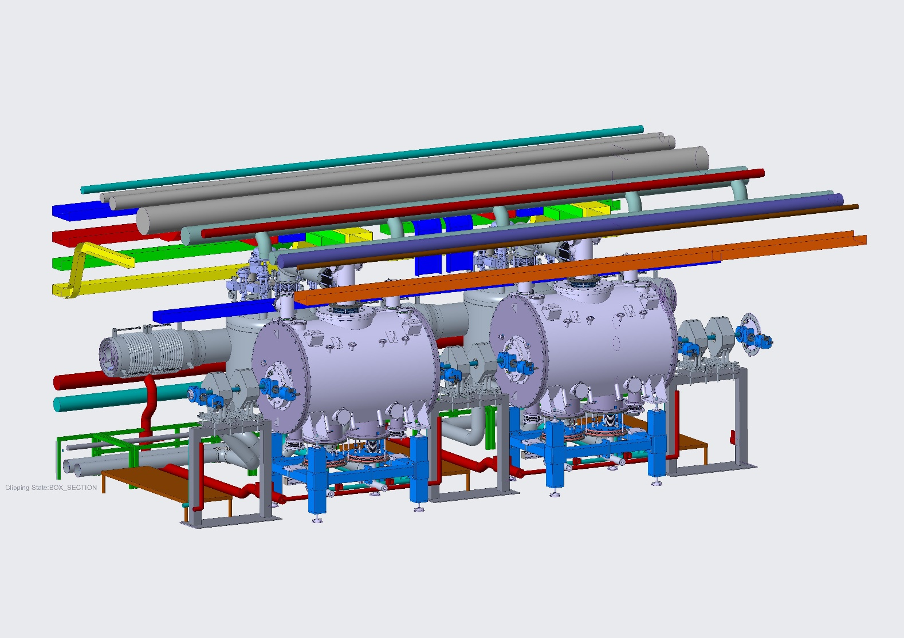
The Superconducting RF LINAC
Cryomodule (QM)
→ each QM contains 2 cavities (CAV)
Low-beta LINAC
Injector
To the Application Centers
Beam direction
100 MeV
16.6 MeV
30 Cryomodules along the LINAC
QM
All QM’s are identical

Slide 7
CryoModule (QM)
QM Facts
30 identical pieces
Dimensions:
Diameter - 1.3 m
Length - 2.2 m
2x supercondictive cavities (CAV) per QM operating temperature 2K
Cooling medium: Liquid He
Pressure Beam pipe: <1E-8 mbara
Pressure QMST (insulating): 1E-6 mbara
To the Valve Box (QVB)
QMST
Chimney (jumper connection)
Thermal shield
Helium bath at 2 Kelvin
RF Cavities
(CAV)
QM
Beam pipe
Tuning
System (TUN)
Magnetic Shield
(MGS)
RF Coupler
(CPLR)
Since we have vacuum, we always use ABSOLUTE pressure in our specs/documentation

Slide 8
QSYS – System Breakdown
Cryoplant & Infrastructure
WCS
QRB
WSH
WSH
WSH
WPS
Cryo Distribution Backbone
QLM
QVB
QVB
QVE
Cryomodules QM
(30x)
QM
QM
QCELL

Slide 9
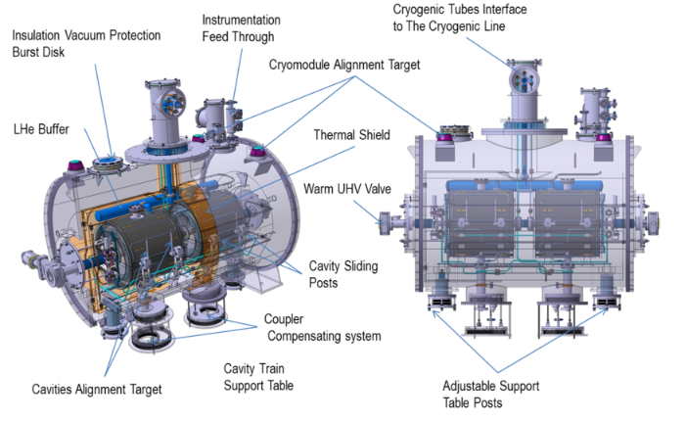
CryoModule (QM)

Slide 10
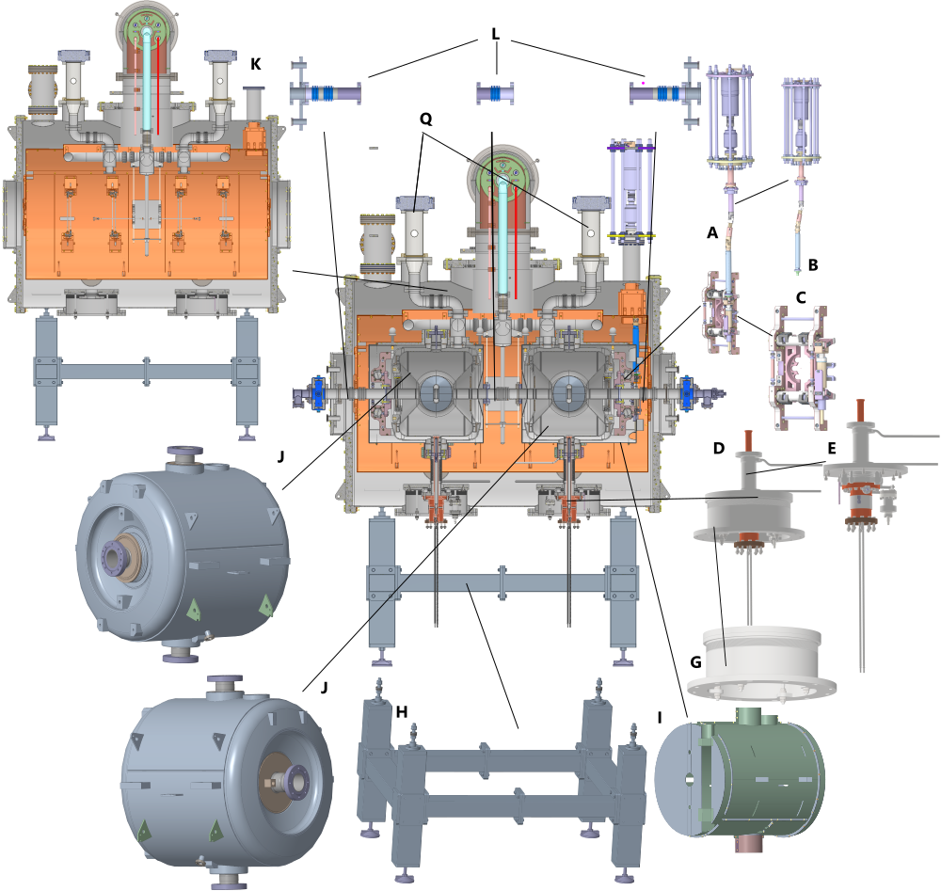
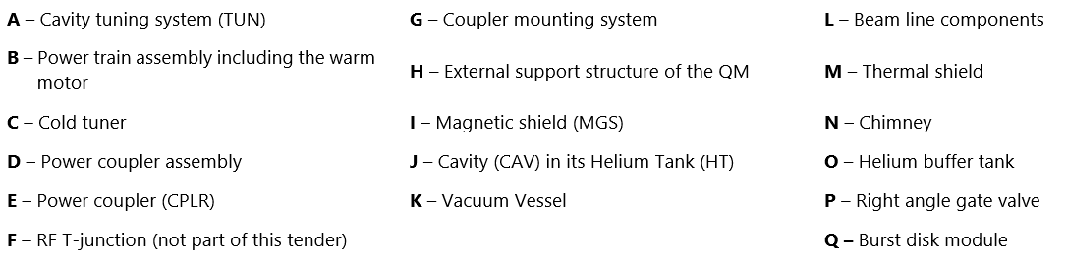
CryoModule (QM)
To the Valve Box (QVB)
QMST
Chimney (jumper connection)
Thermal shield
Helium bath at 2 Kelvin
RF Cavities
(CAV)
QM
Beam pipe
Tuning
System (TUN)
Magnetic Shield
(MGS)
RF Coupler
(CPLR)

Slide 11
QM – Volumes
MX
XM
Name | Volume (L) 10% error possible
Q1 | 1935
L1 | 26.5
L2 | 26.5
M | 8.4 (liquid He volume) 26.8 (vessel volume)
P | 124.2
M
P
L1
L2
Q1
P = BVAC volume
L, M = Helium bath volume
Q = INVAC volume, corresponds to Q1 for the QM

Slide 12


QM – Pressures
NFS scope
MX
XM
Name | MAWP (bara)
Q1 | 1.5
L1 | 2
L2 | 2
M | 2
P | 2
BD561
MV2
MV1
M
SV590
BD560
P
L1
L2
Q1
P = BVAC volume
L, M = Helium bath volume
Q = INVAC volume, corresponds to Q1 for the QM

Slide 13
QM – Pressures
NFS scope
MX
XM
Pressure safety device | Opening/Burst pressure (bara)
SV 590 | 1.1 – 1.5
BD 560 & 561 | 2.0
BD561
MV2
MV1
M
SV590
BD560
P
L1
L2
Q1
P = BVAC volume
L, M = Helium bath volume
Q = INVAC volume, corresponds to Q1 for the QM

Slide 14
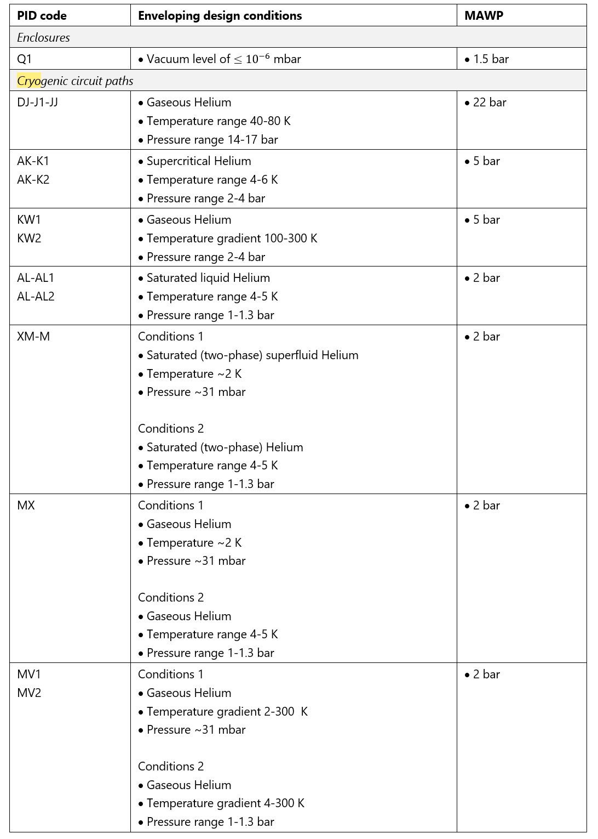
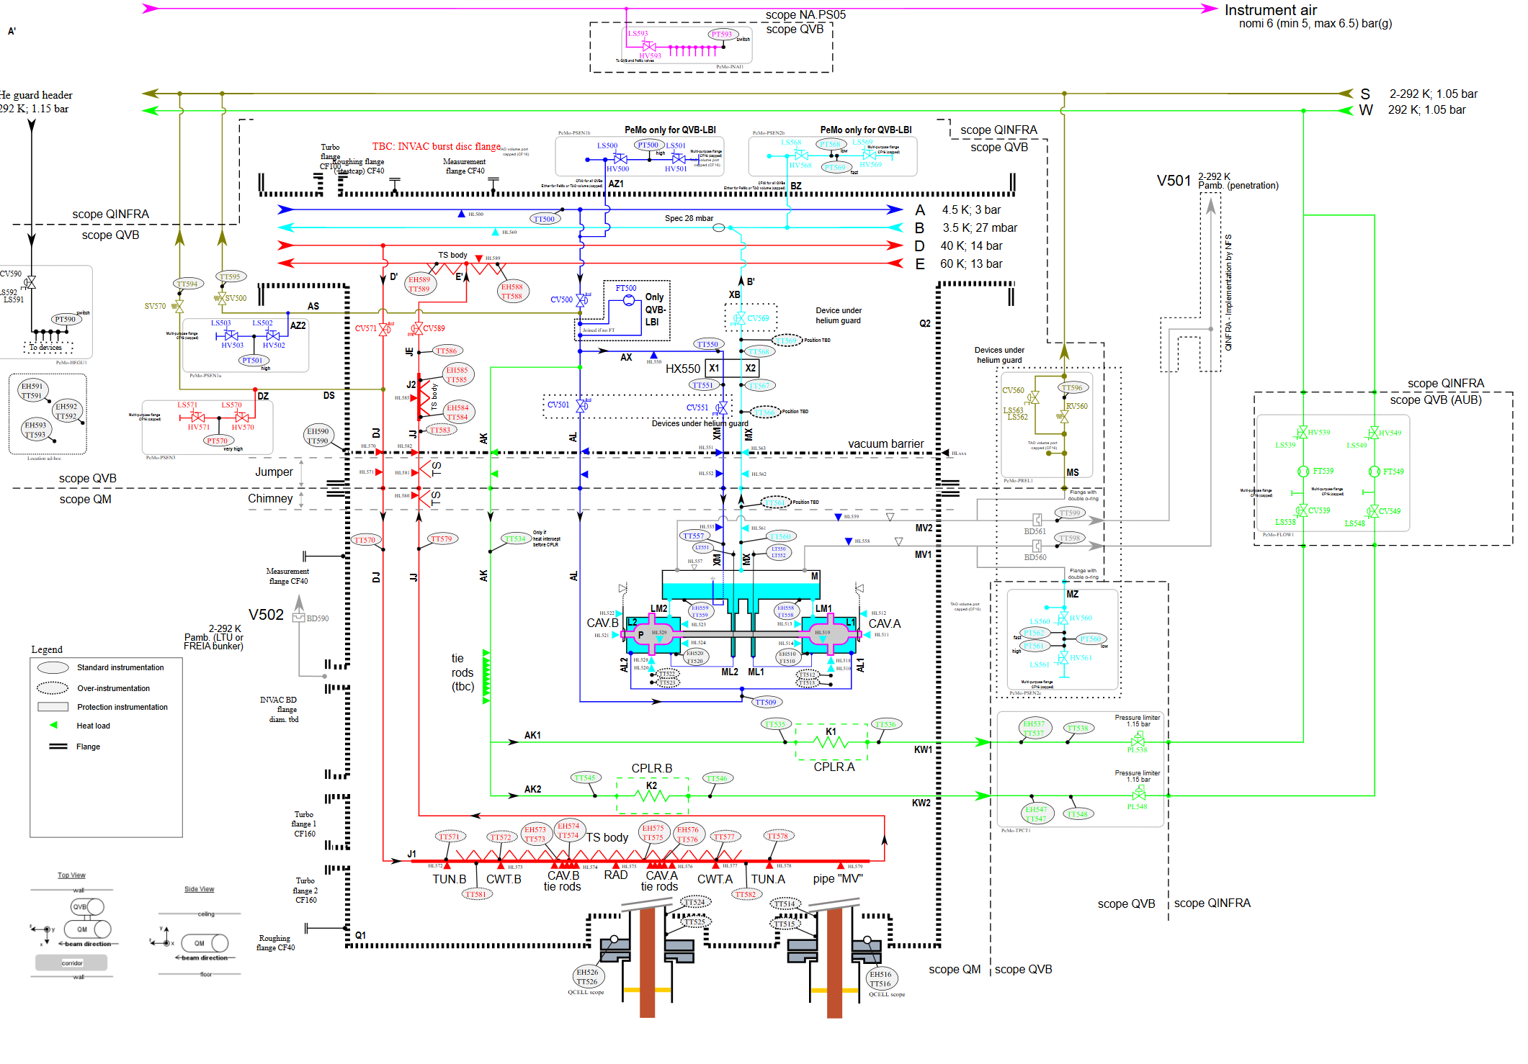
PID ALX/55801725
QMST tender ALX/43737760

Slide 15
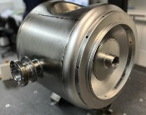
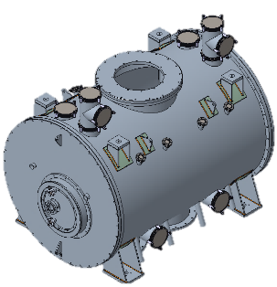

CryoModule (QM) – PED compliance
Context
The cryomodule is not supplied to SCK CEN by a single supplier
Pressurized equipment involved:
CAV → supplied by contractor X
QMST → supplied by contractor Y
- QM assembly → done by a contractor Z
Contractor contractually not required to follow PED Technically not possible to pressure test as this would deform the geometry and cause an offset in resonance frequency rendering the cavity useless
Contractor contractually required to apply PED
Contractor contractually required to apply PED

Slide 16
CryoModule (QM) – PED compliance
What is needed to declare PED compliance (by SCK CEN) for the cryo module assembly?
PED category to be determined ?
Technical file content ?

Slide 17

Cryogenic system – PED compliance
Cryo Plant
WCS
QRB
WSH
WSH
WSH
Cryo Distribution Backbone (QDB)
Cryo Plant comes with it’s own EU declaration of conformity for PED provided by contractor
QDB comes with it’s own EU declaration of conformity for PED provided by contractor
QM comes with a EU declaration of conformity for PED self declared by SCK CEN
QLM
QVB
QVB
QVE
Cryomodules QM (30x)
QM
QM

Slide 18
Cryogenic system – PED compliance
Cryogenic system
Cryo Plant
WCS
QRB
WSH
WSH
WSH
Cryo Distribution Backbone
What is needed to declare PED compliance (by SCK CEN) for the complete Cryo System?
What is the minimum content of the technical file?
Is there any specific documentation that we need to receive from the contractors? Test reports, material certificates, …
Are there any tests required on the assembled system to be carried out onsite (in Mol) ?
QLM
QVB
QVB
QVE
Cryomodules QM (30x)
QM
QM

Slide 19
Copyright © SCK CEN
PLEASE NOTE!
This presentation contains data, information and formats for dedicated use only and may not be communicated, copied, reproduced, distributed or cited without the explicit written permission of SCK CEN. If this explicit written permission has been obtained, please reference the author, followed by ‘by courtesy of SCK CEN’.
Any infringement to this rule is illegal and entitles to claim damages from the infringer, without prejudice to any other right in case of granting a patent or registration in the field of intellectual property.
SCK CEN
Belgian Nuclear Research Centre
Foundation of Public Utility
Registered Office: Avenue Herrmann-Debrouxlaan 40 – BE-1160 BRUSSELS
Operational Office: Boeretang 200 – BE-2400 MOL

Slide 20
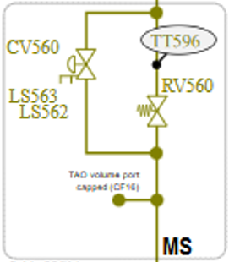
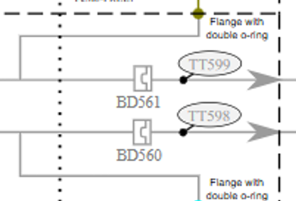
QM – Pressure differences
ALX/91198270
Z
Q
L
P
Footnote
2b, L: Capped by CV560
3a/b, L: Capped by BD560&1
3b, Q: Capped by INVACs BD

Slide 21

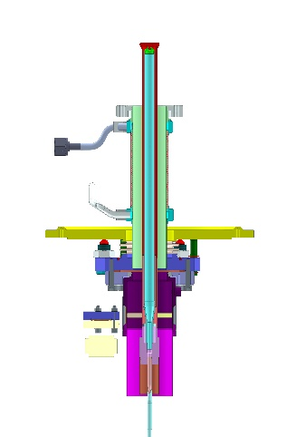
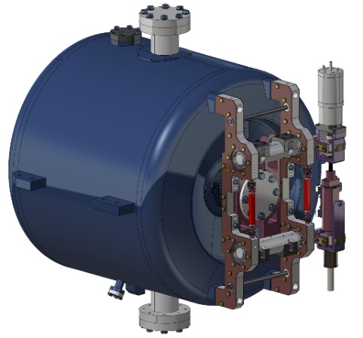
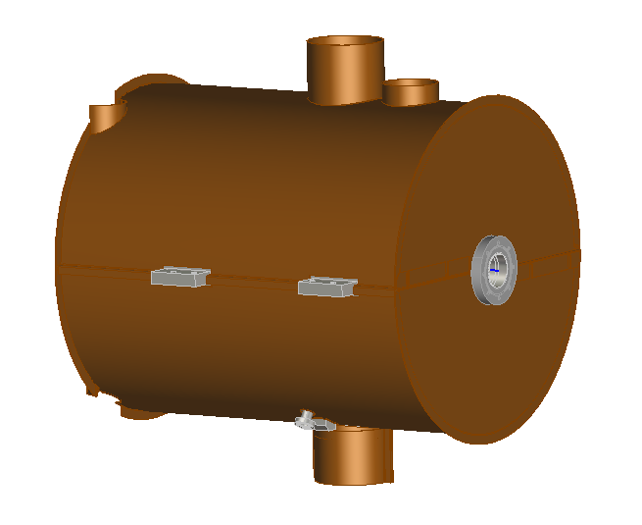
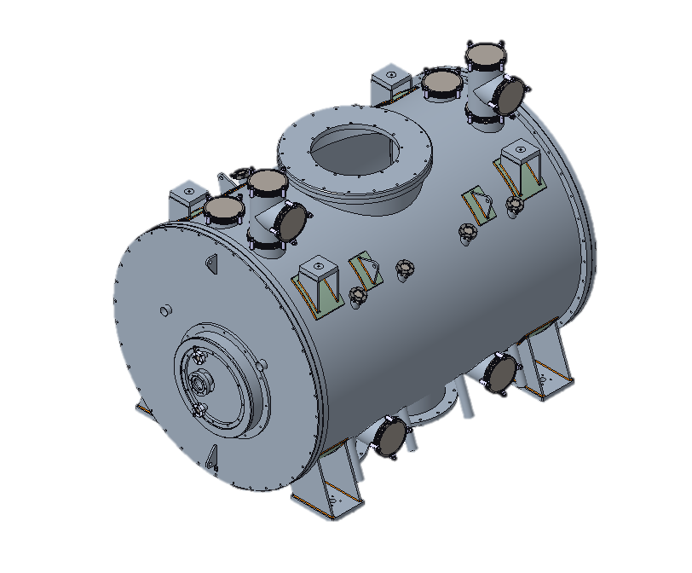
The Cryocell (QCELL)
Cryo-Cell (QCELL)
Cavity assy (2x)
Cavity (CAV)
Coupler (CPLR)
Cryostat (QMST)
Valve-box assy
Vacuum Vessel
Vacuum Vessel
Jumper
Vacuum Barrier
Cryomodule (QM)
Valve box (QVB)
Cold Tun. Syst. (TUN)
Cryogenic tank+pipes
Thermal Shield
Mag. Shield (MGS)
SBS Breakdown
CAV
CPLR
TUN
MGS
QMST

